Slide 1



DEPARTMENT OF COMPUTER SCIENCE
RAVEN
FINAL YEAR PROJECT
Project Supervisor: Dr. Usama Ijaz Bajwa
Muhammad Barak Ullah SP18-BCS-031
Burhan Sabir SP18-BCS-015
Muhammad Saim Ashfaq SP18-BCS-115

Slide 2
Problem
Tools & Technologies
06
01
Dataset
Proposed Solution
07
02
TABLE OF CONTENTS
Model
08
RAVEN
03
Challenges
09
Objectives
04
Future Work
10
Working Flow
05
The problem that caused this solution to be created
Tools & technologies we used in development process
Comparing different datasets performance
Proposed solution against the problem
Compare different Re-id models
A Desktop application for person re-identification
Challenges faced during the development
Objectives of application
Extension in current project
Basic working flow of the application

Slide 3


Problem Statement
The problem we are dealing with is detecting and tracking the person, but the problem arises when a person disappears from one camera and then reappears in the other camera, his previous track would be lost.

Slide 4

Proposed Solution
A brief outline
Process of re-identification counters the problem by recognizing the individual in different locations even on large space with multiple non overlapping cameras.
It detects and re-identifies the person who has previously been seen in network of cameras that come under our system domain.

Slide 5
RAVEN
Detects, tracks and re-identifies the person.
Save frames of that person.
Displaying tracklets on id basis.
1
2
3
4
5
6
A desktop-based application.
Save record of that person.
View report of previous appearances of person.

Slide 6


Objectives
To detect, track and re-identify multiple people
To save record and tracklets of person i.e., Appearance time and videos
To build a system with low computational cost

Slide 7
Working Flow of RAVEN
Person’s record is saved into database
Model re-identifying and tracking the person
Video stream from cameras
User monitoring the stream

Slide 8





Tools & Technologies
GOOGLE COLAB
For model training and testing purpose
PYQT5
For making interactive UI of application
OPEN-CV
For front-end of the application i.e., displaying of videos
SQLITE
For managing database end of the application

Slide 9
yy
Re-Identification - Dataset
Market1501
19,000+ test images
12,000+ train images
1,000+ query images
M->M = 91.2
DukeMTMC-reID
17,000+ test images
16,000+ train images
2,000+ query images
DM->DM = 82.0
Dataset
MSMT17
80,000+ test images
1,20,000+ train images
4,000+ query images
MSMT->MSMT = 61.4
Combine Dataset
70,000+ test images
111,000+ train images
5000+ query images
M+DM+MSMT -> M = 73.3

Slide 10
Inference Engine - Models
YOLO V3
OSNet model
We have used YOLO V3 for detection and tracking purposes
We have used OSnet model for Re-identification purpose

Slide 11
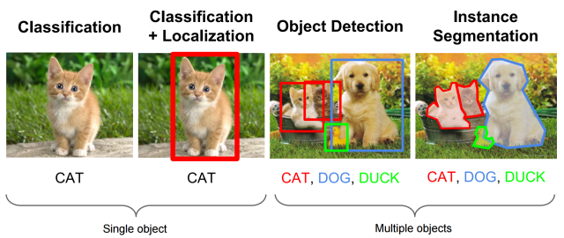
YOLO V3
YOLO V3 Working
Single Object
Multiple Object

Slide 12
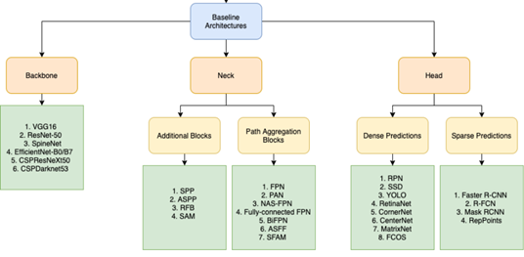
YOLO V4
YOLO V4 Architecture

Slide 13
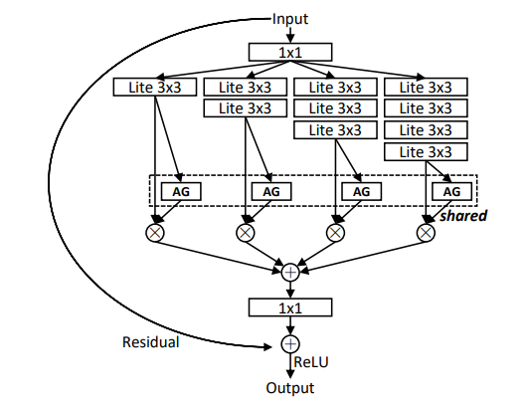
OSNet Model
OSNet Working

Slide 14

OSNet Model
Why OSNet?
Model | # Param (10^6) | GFLOPs | Loss | Distance
Resnet50 | 23.5 | 2.7 | SoftMax | Cosine
osnet_x0_75 | 1.3 | 0.57 | SoftMax | Cosine
osnet_x0_5 | 0.6 | 0.27 | SoftMax | Cosine
osnet_x0_25 | 0.2 | 0.08 | SoftMax | Cosine

Slide 15


Integration of Models
YOLO - OSNet
Firstly, Yolo V3 will do detection and tracking on the video provided by the user and the tracked video will be saved in the directory.
The tracked video will be then passed to the OSNet model for the re-identification and then after reidentification, complete video will be saved in directory.
Input video
YOLO V3
Tracked video
OSNet

Slide 16
Challenges we faced
1
Google Collab limitation
Efficiency Issue
Real Time Application
2
3
Use of OSnet Model
Integration of Yolo and OSnet
Time Efficiency
4
6
5

Slide 17

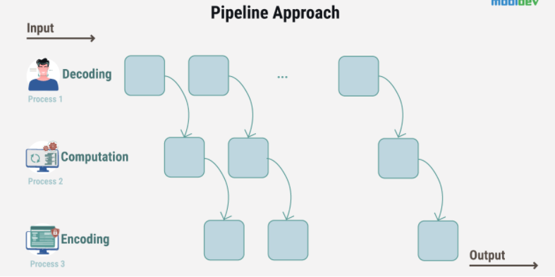
PIPELINING
PICTORIAL REPRESENTATION

Slide 18
MAKING OUR PROJECT TIME EFFICIENT
PIPELINING
The main issue that we faced during our project was of time complexity. After getting video from the user, we divide the video into no. of chunks depending upon the no. of cores user’s CPU has. Total frames of the video will then be divided by no. of chunks made.
VIDEO
No. OF CORES
CHUNK1
CHUNK2
CHUNK3
CHUNK4

Slide 19
MAKING OUR PROJECT TIME EFFICIENT
PIPELINING
Number of these chunks were handled dynamically i.e.; they are dependent on no. of cores users' system has. For example, if the video is run on a quad-core processor, video will be divided into four chunks as quad-core processor has four cores.
No. of chunks = No. of CPU cores
.
CHUNK1
CHUNK2
CHUNK3
CHUNK4
YOLO
Tracked video + Tracked video + Tracked video + Tracked video
OSNET
COMBINED VIDEO

Slide 20
MOBILE BASED APPLICATION
Could be extended to a mobile based application.
TO THE FUTURE
CLOUD BASED PRODUCT
Could provide cloud-based services.
INTEGRATING PIPELINING
C
Integrating work done in pipelining with the application.

Slide 21



ADDITIONAL READING
MPVIR Group - RAVEN
https://sites.google.com/view/mpvir/projects/raven?authuser=0
Re-Id Datasets
https://kaiyangzhou.github.io/deep-person-reid/datasets.html#
Model Zoo
https://kaiyangzhou.github.io/deep-personreid/pkg/models.html#reid-specific-models

Slide 22
Be Inspired
IMAGINATION IS MORE IMPORTANT THAN KNOWLEDGE.
ALBERT EINSTEIN

